Slide 1
Reviewing Game Design
Mark Biswell

Slide 2
What Is Game Design?
Game Design is the art of defining the rules, content, story and gameplay elements of a game. Game designers are the ones with an end vision for the game they are creating, they shape these elements during the design process in order to make that vision reality. Game design is a highly creative process that follows a clear but highly flexible formula. This flexibility and creative opportunities allow for games to be designed to feel familiar as to not alienate stakeholders, but at the same time, be different enough to keep users interested in video games as a whole for many years.
Notes:
Game Design is the art of defining the rules, content, story and gameplay elements of a game. Game designers are the ones with an end vision for the game they are creating, they shape these elements during the design process in order to make that vision reality. Game design is a highly creative process that follows a clear but highly flexible formula. This flexibility and creative opportunities allow for games to be designed to feel familiar as to not alienate stakeholders, but at the same time, be different enough to keep users interested in video games as a whole for many years.

Slide 3
Why Is It Needed?
Game Design is needed in order to create and maintain a clear end goal of what you/the team wants to achieve. The design process allows the creators to explore new ideas and create new experiences for the stakeholders. If game design didn’t exist, all games would be created with the same feel and predictable gameplay and patterns that

Slide 4
What Is The Result?
Using the correct game design techniques and putting effort and thought into the design of your game results in a game that is robust and profitable. Games can only be profitable when your target audience is happy and captivated by your game. And this all starts by having in place a good plan and solid design that follows established guidelines and provent methods.

Slide 5
Timeline of Video Games

Slide 6
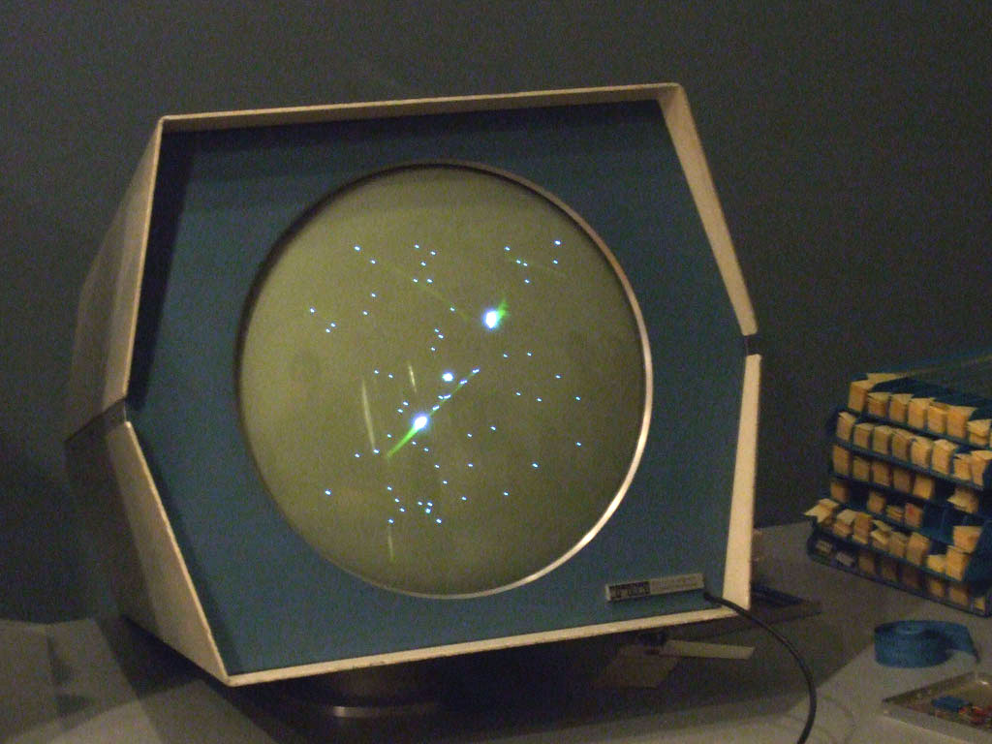
1960’s
Widely considered to be the decade that videos games as we know it were created
First video game was called ‘Spacewar!’
Created by Steve Russell, computer scientist from the U.S
Created for the PDP-1
2 player local multiplayer
Each player controls a ship, they fight each other around a star in the middle of the screen
Was created as a challenge to try and push the hardware
Notes:
The 1960s is widely considered to be the decade in which video games were invented. One of the first video games ever created was made it 1962 and is called Spacewar. Spacewar was developed for use on the PDP-1 computer system by a man called Steve Russell, a computer scientist from the United States who studied at Dartmouth College. At the time the concept of a video game had barely even been established in the computer world, mainly in part due to hardware limitations that could prevent real time user interaction with something as complex as a game. Steve wanted to push the hardware to see what was possible, he came up with Spacewar.
Spacewar is a 2 player game that is played by both players on one machine. It involves two ships, referred to as ‘The Needle’ and ‘The Wedge’. The two ships fight each other around a star that is located in the middle of the screen. Both ships are equipped with limited torpedos and fuel with which to fight each other. They also have a ‘hyperspace’ warp that can be used to disappear and reappear at a random location on the screen, however there is a chance that your ship could be destroyed that increases each time you hyperspace jump.
Spacewar was originally played by using the switches that were on the PDP-1. This presented problems as the game was very difficult to control. To solve this, Steve created a simple control pad device that is considered to be the first gamepad ever created.

Slide 7
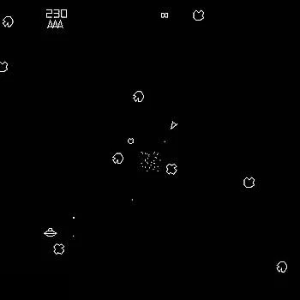
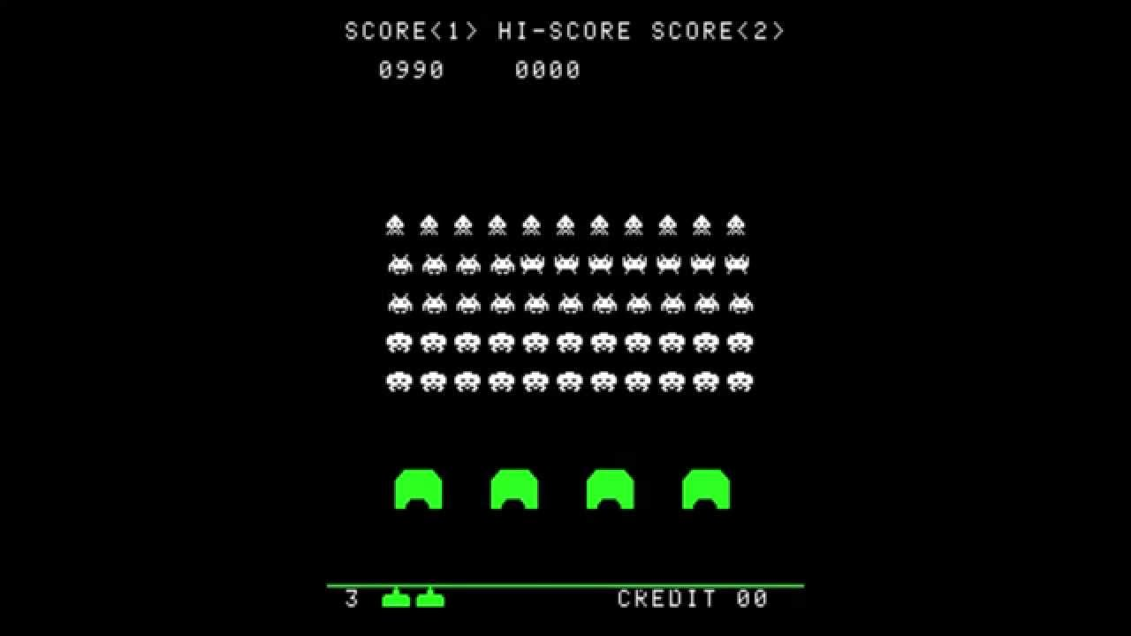
1970’s
Regarded as the ‘Golden Age’ of arcade video games
2 most notable games are ‘Asteroids’ (1979) and ‘Space Invaders’ (1978)
Asteroids was created by the American video games company ‘Atari’
Space Invaders was created by the Japanese video games company ‘Taito’
Both of these games have be re-released many times due to their success as arcade games
In this decade, home consoles were still an early concept so arcades were the most popular way to play video games.
Notes:
The 1970’s is often regarded as the the golden age of arcade video games. This decade saw video games become mainstream and accessible to almost anyone in the western world. During this time, the popularity of public arcades peaked and some of the most well known arcade games were published.
One of the most well known arcade games published in 1978 is ‘Space Invaders’. In this game you control a ship that you can move left and right as you attempted to destroy wave after wave of alien ships/ The game ends when the player loses all of their lives. Each ship is worth a different amount of points when they are destroyed. Space Invaders was created by Tomohiro Nishikado, the original concept for the game was to have a tank shooting at aeroplanes, however technical limitations meant that creating aeroplanes that fly correctly wasn’t possible. To solve this, he adapted the original concept to be in space, so that the ships could move any way he wanted.
Asteroids was another popular arcade game that was released in 1979. It was developed by the American video game company Atari. In the game, the player controls a spaceship that is in the middle of an asteroid field. The objective is to destroy as many asteroids as possible without being hit by them. Alien saucers also appear at random intervals and attempt to shoot and destroy the player.

Slide 8
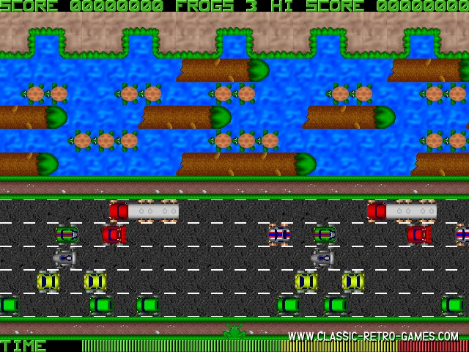

1980’s
Considered ‘The Decade of Ups and Downs’ for video games
Lack of quality games to blame for North American video game market crash
Crash nearly completely destroyed the industry
However the start of the 80s brought some of the most memorable video games ever created
Notable games include ‘Pac-Man’ (1980) and ‘Frogger’ (1981)
Considered to be the worst video game ever, E.T the Extra-Terrestrial released in 1982
Notes:
The 1980’s was a decade that was full of many ups and downs for the video game industry, especially in North America. The 1980’s started well with some of the most popular arcade games being released, and home consoles started to appear and become commonplace.
Pac-Man was released in 1980 and was created by the Japanese company Namco. In this game you control a circle shaped sprite and move around a maze inhabited by 4 different ‘ghosts’ that try to make contact with the player, resulting in the player losing a life. The player is tasked will collecting small dots that are placed all around the maze. When all of them are collected, the player is sent to another maze with the speed of the ghosts slightly increased to make the game more difficult. The game was an instant global success when it was launched due to its skill ceiling being deceptively high, making for an excellent competitive game and a great test of game knowledge.
However the downsides to this decade quickly came about. When E.T the Extra Terrestrial was released for the Atari 2600 in 1981, the game attracted immediate and well deserved criticism from the gaming community. As the game is based on the film with the same name, a lot of expectation was placed on the game that it did not live up to with boring gameplay and a complex and yet almost absent story. This created a lot of distrust between players and developers, leading to a massive loss of sales for the remainder of the decade which in turn resulted in the biggest video game market crash of all time.

Slide 9

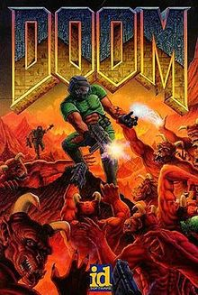
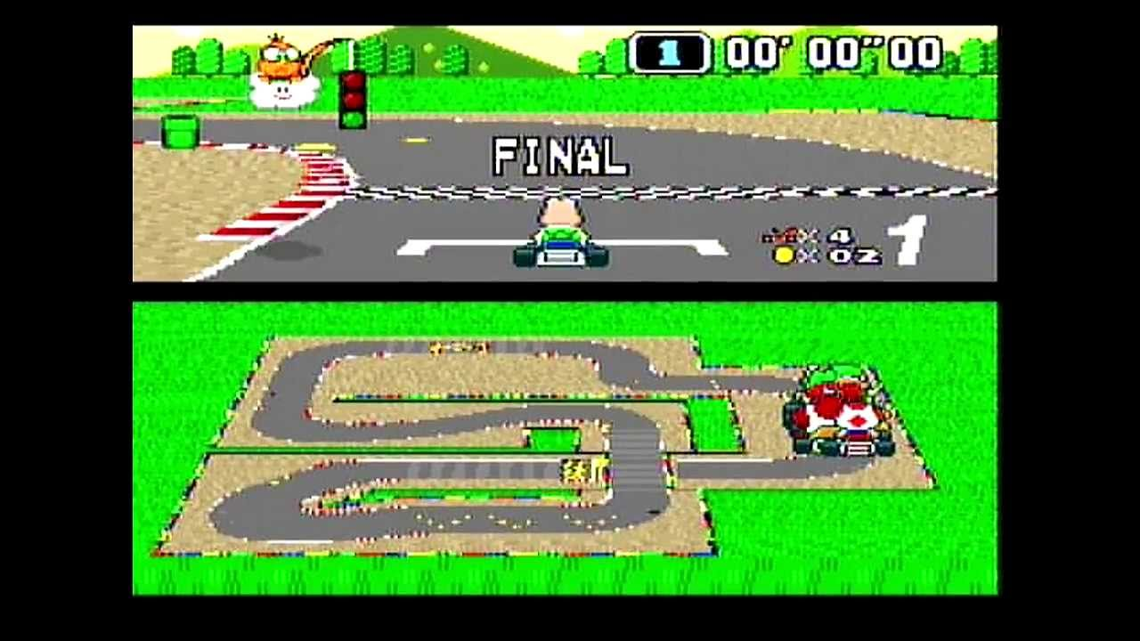
1990’s
This decade brought about the leap to 3D graphics
This allowed for the creation of new game genres such as First Person Shooters and Real-Time Strategy games
Handheld gaming became a reality in the mid-late 90s
Notable games include ‘DOOM’ (1993), ‘Mario Kart’ (1992) and ‘Pokemon’ (1996)
Popularity of arcade gaming fell as home consoles became commonplace
Online multiplayer start being developed
Notes:
The 90’s was the decade when video games began to more closely resemble what we today think of as true video games. This is mostly due to the developments made in rendering 3D images and polygons. This advancement in technology immediately allowed developers to make massive changes and advancements to how they design their games.
Notable example of games that took advantage of the new technology include ‘DOOM’ and ‘Mario Kart’
Doom was released in 1993 and is often regarded as the father of first person shooters. With the rise of 3D graphics came the creation of new genres of games. The most popular of these new genres was the first person shooter. This new genre gave players a whole new perspective on the game worlds they play in, leading to more immersive and detailed games. Doom is a first person shoot in which the player is tasked with adventuring through different levels killing various demon like creatures.
Mario Kart on the other hand is a game that used the new technology to focus on a younger demographic, but still ended up being very successful due to the already well established Super Mario franchise. The idea behind mario kart was simple, the player races against 7 other opponents (AI or Local multiplayer).

Slide 10
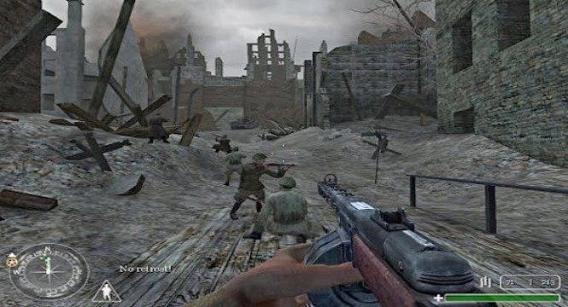
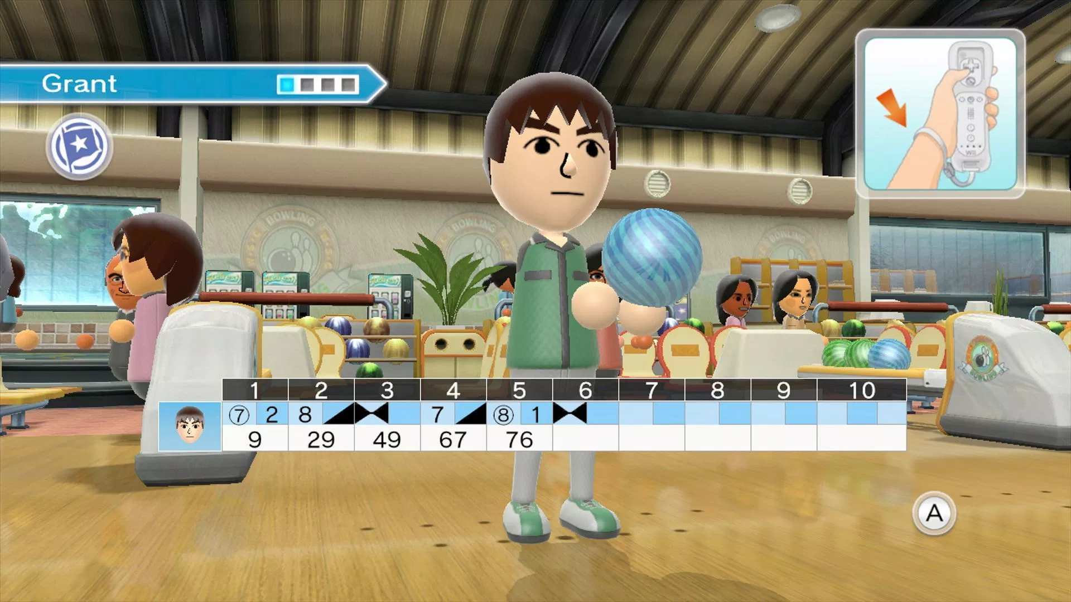
2000’s
The 2000’s brought about rapid advancements in graphical fidelity.
By the late 2000’s, high definition gaming was a reality
Online gaming also saw rapid growth in the late 2000’s
Motion controls began to see widespread implementation in the mid to late 2000’s
Notable games include ‘Call of Duty’ (2003) and ‘Wii Sports’ (2006)
Notes:
The 2000’s was a decade that mostly expanded on what was already well established, however did bring about a significant increase in the graphical fidelity of available games. However one of the most notable developments for gaming came in 2006 with the release of the Nintendo Wii home games console. The most distinctive selling point for the Wii was the new motion controls that the console was heavily based around.
Physical activity whilst gaming was not something that had ever been considered in the past. The Wii was a turning point that made the world stop seeing computer games as something played only by lazy people. The Wii was a true family console that could be played by everyone.
The Wii console also shipped with a copy of Wii Sports, which is still to this day, one of the top 10 highest selling video games of all time. Wii sports made excellent use of the Wii’s motion controls allowing for anyone to pick up the controller and have a basic understanding of how to play. With sports such as tennis and 10-pin bowling, it was not only seen as a fun family game, but also as a way to get people on their feet and moving around, even while playing video games.

Slide 11
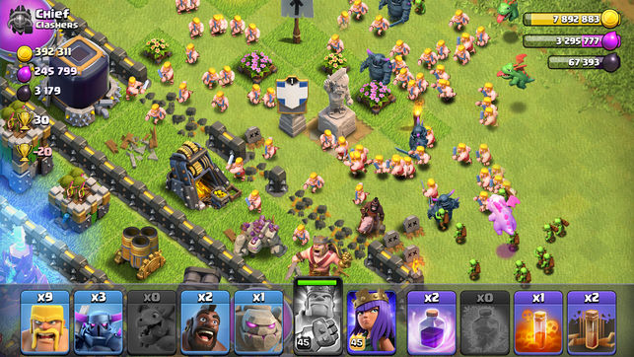
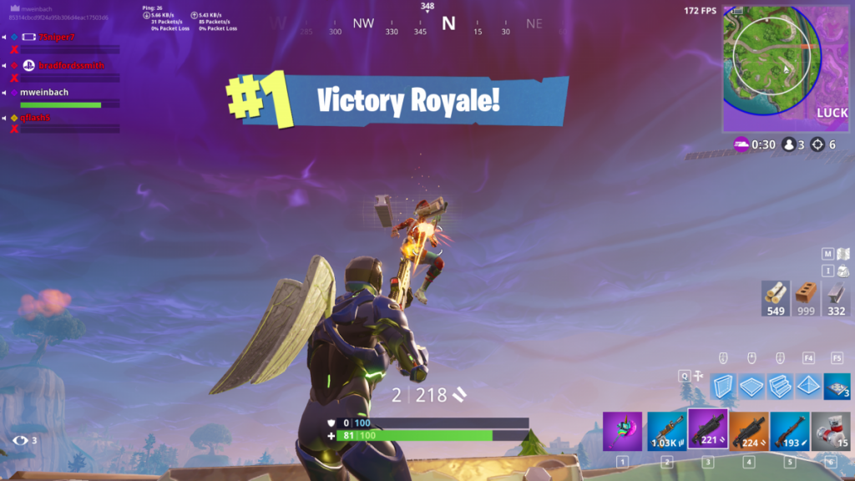
2010’s
The 2010’s are notable for starting the idea of ‘Casual Gaming’ on a mobile or tablet device
Despite this, the video game market remains dominated by Sony, Microsoft and Nintendo
Further advancements in gaming hardware allow for extremely realistic visuals
Virtual Reality is beginning to become commonplace as of the late 2010’s
Notable games include ‘Clash of Clans’ (2012) and ‘Fortnite’ (2017)
Notes:
The 2010’s is considered as the fifth decade of mainstream gaming. In this decade there has been a sharp increase in the graphical fidelity of games, with current PC hardware and home consoles even pushing 4K UHD gaming support in the late 2010’s. This current decade also started the idea of ‘casual gaming’ on mobile or tablet devices. Games such as ‘Clash of Clans’ opened up gaming to a much wider demographic than other games before it, mostly due to smartphones becoming commonplace in today's society. On the more dedicated side of gaming. 2017’s ‘Fortnite’ had a major impact on the gaming market and is partly responsible for the more recent popularity of the ‘Battle Royale’ genre of video games, in which a large number of players compete to be the last man standing in an ever shrinking play area.
2012’s Clash of Clans was an instant success amongst mobile gamers when it launched. The idea of the game is to create a base and build an army to attack other players with. Multiple people can band together to form a clan. The concept of playing a game on the go against other people around the world was new to a lot of people who had never played video games before.
2017’s Fortnite is currently the most played game over all platforms (in terms of concurrent players). As said before the idea behind a battle royal game is that a large number of players, in Fortnite’s case 100, compete to be the last man standing whilst the playing area shrinks in size in order to force conflict between players. Fortnite’s cartoon art style is part of the reason it has seen massive success amongst a younger audience of kids ranging from 10-15 years old.
The one thing that both of these games have in common is that they are Free to Play games. This is a good way to attract a large number of players to try your game as potential players are more inclined to try the game if they don’t have to sink any money into it. This is the main reason as to why both of these games continue to be very popular today.

